Slide 1
The ABC of the 21st Century. The Latest Edition (2020)
from A to Z

Slide 2
A a

Slide 3
B b

Slide 4
C c

Slide 5
D d

Slide 6
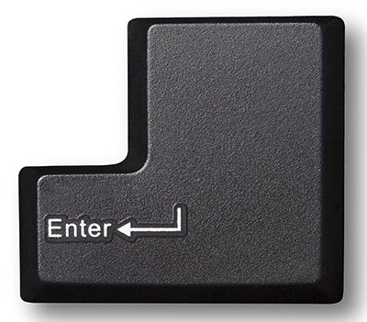
E e

Slide 7
F f

Slide 8
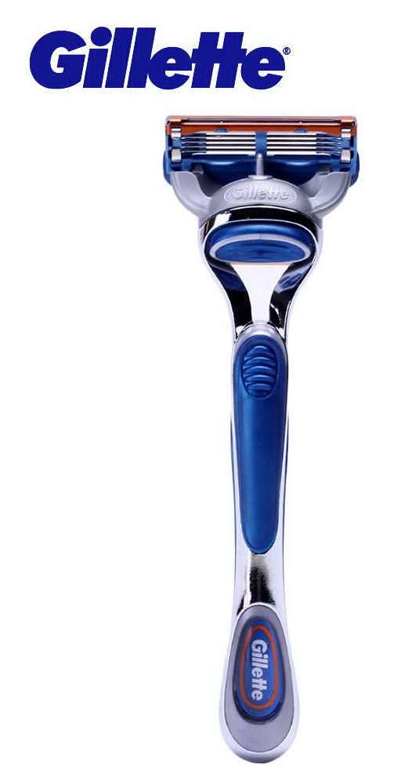
G g

Slide 9
H h

Slide 10
I i

Slide 11
J j

Slide 12
K k

Slide 13
L l

Slide 14
M m

Slide 15
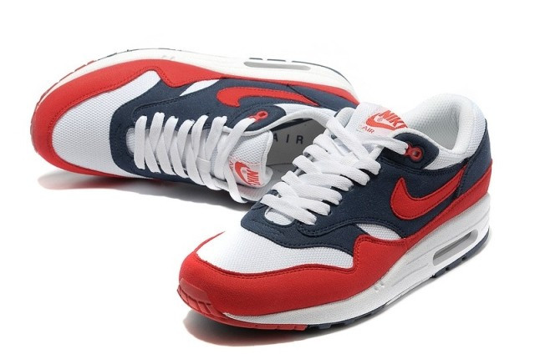
N n

Slide 16
O o

Slide 17
P p

Slide 18
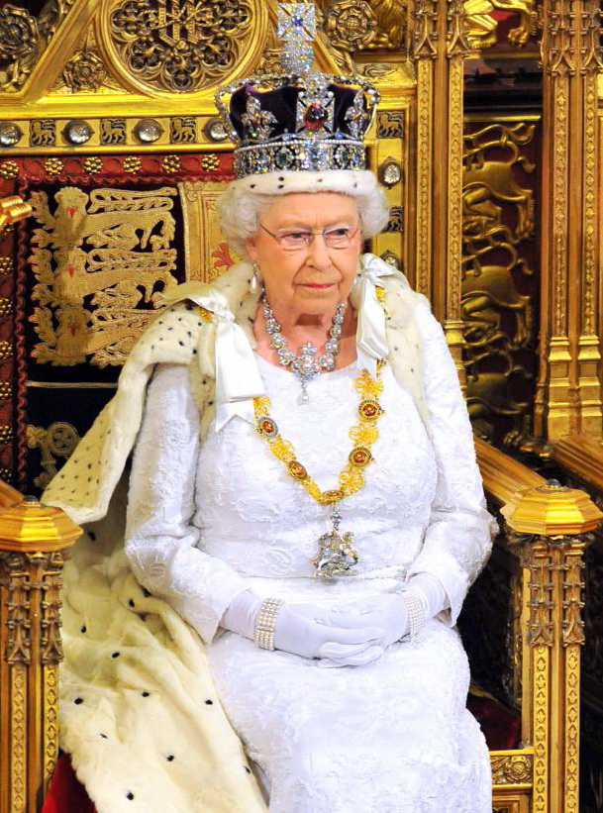
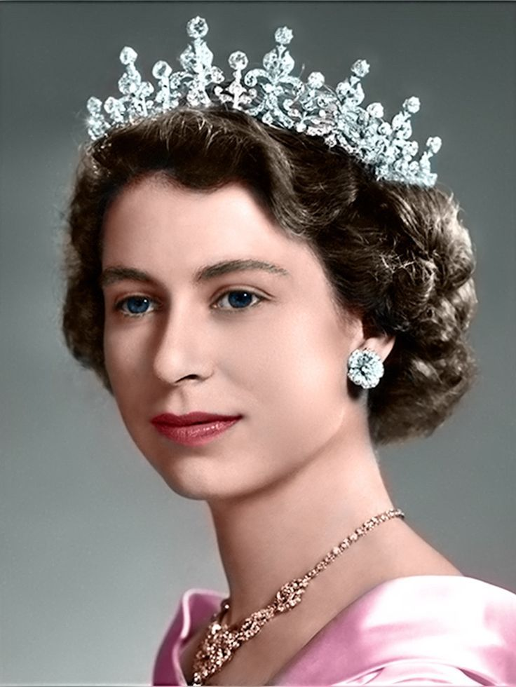
Q q

Slide 19
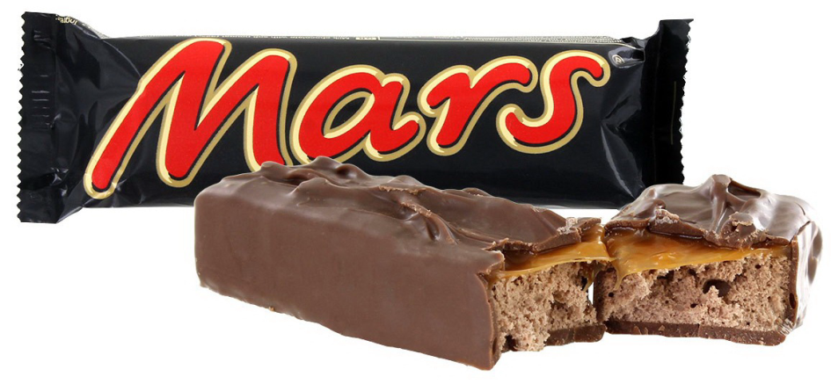
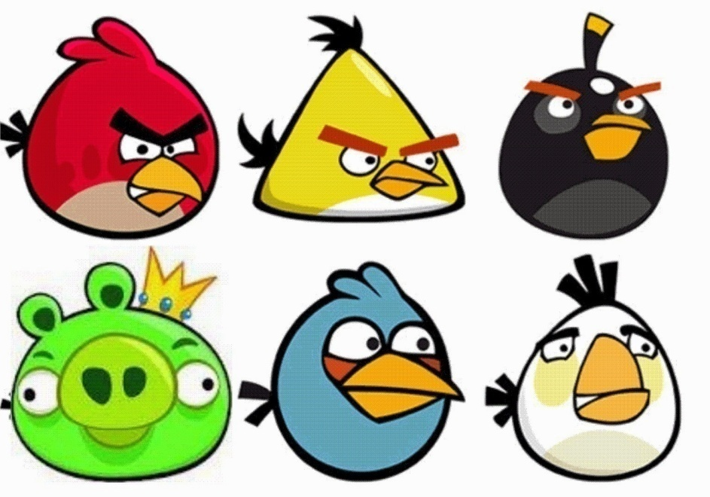
R r

Slide 20
S s

Slide 21
T t

Slide 22
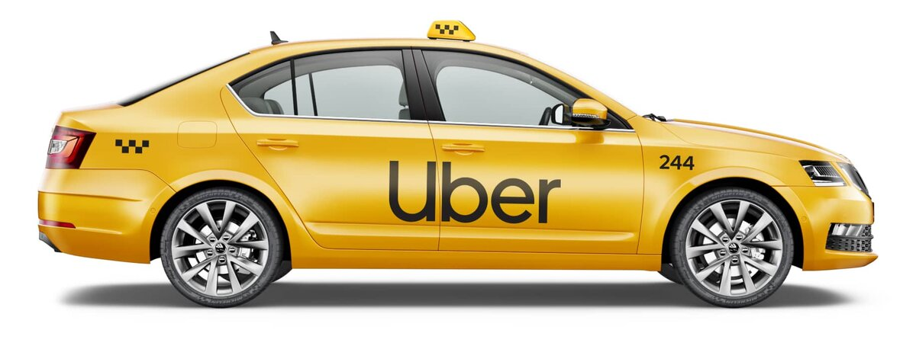
U u

Slide 23
V v

Slide 24
W w

Slide 25
X x

Slide 26
Y y

Slide 27
Z z

Slide 28
THAT’S ALL, GUYS! THANK YOU FOR YOUR ATTENTION!

